Slide 1
Band-Aids on a Gunshot Wound
Deborah & Barak (Judges 4–5)
Dr. Andrew Spurgeon, Crossroads International Church Singapore
BibleStudyDownloads.org

Slide 2
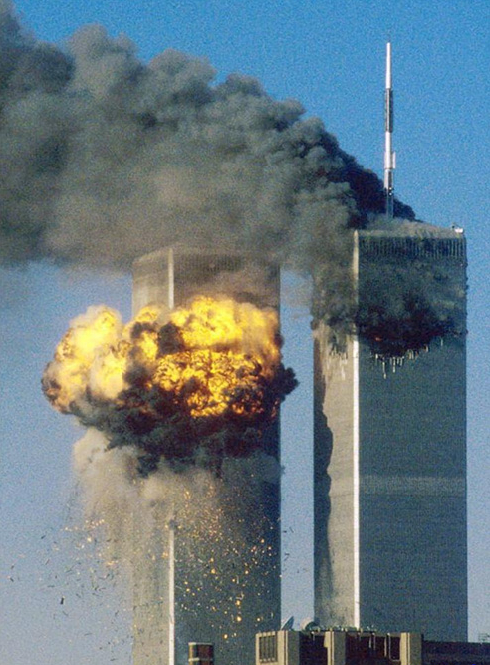

Slide 3
September 11, 2001
On September 11, 2001, nineteen terrorists hijacked four airliners and carried out suicide attacks against targets in the United States
Two of the planes were flown into the towers of the World Trade Center in New York City, a third plane hit the Pentagon just outside Washington, D.C., and the fourth plane crashed in a field in Pennsylvania
Over 3,000 people were killed during the attacks in New York City and Washington, D.C., including more than 400 police officers and firefighters.

Slide 4
Terrorist Acts Leading up to 9/11
1979 Terrorists seized the US Embassy in Iran and held 52 American hostages for 444 days
1983 Bombed US Embassies in Lebanon and Kuwait; and US Marine barracks in Beirut
1984 Kidnapped, tortured, and killed CIA Station Chief William F. Buckley in Lebanon; bombed US Air Force base in Spain; US Embassy in Beirut; Hijacked Kuwait Airlines Flight 221 and murdered the passengers

Slide 5
Terrorist Acts Leading up to 9/11
1985 Hijacked TWA Flight 847 and killed hostages; Hijacked the cruise ship Achille Lauro and threw a wheelchair-bound American overboard; Bombed Vienna and Rome airports killing several
1986 Bombed La Belle disco, Berlin
1988 Kidnapped, tortured, and killed US Marine Corps Lt Col William Higgins in Lebanon; Bombed Pan Am Flight 103 killing all

Slide 6
Terrorist Acts Leading up to 9/11
1992 Bombed a hotel in Yemen killing US Marines
1993 First bombing of World Trade Center, NY (7 killed; 1,042 wounded); attempted assassination of President Bush Sr. during his visit to Kuwait; US helicopters shot down in Somalia during Operation Restore Hope
1994 Plot to assassinate President Clinton (Philippines)

Slide 7
Terrorist Acts Leading up to 9/11
1995 Bombed US military headquarters in Saudi Arabia
1996 Bombed US military housing, Saudi Arabia
1998 Bombed US Embassies in Nairobi and Tanzania
2000 Bombed USS Cole in Yemen; Bombed US Embassy in Philippines

Slide 8
The Book of Judges
Terrorist acts led up to that fateful day of September 11, 2001—15 years ago today.
The same was true of the time the Book of Judges speaks about—their evil progressively became worse to the point the writer says, “In those days there was no king in Israel; each person did what was right in his/her own eyes” (21:25).

Slide 9
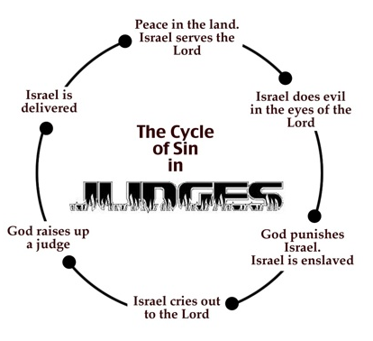

Slide 10
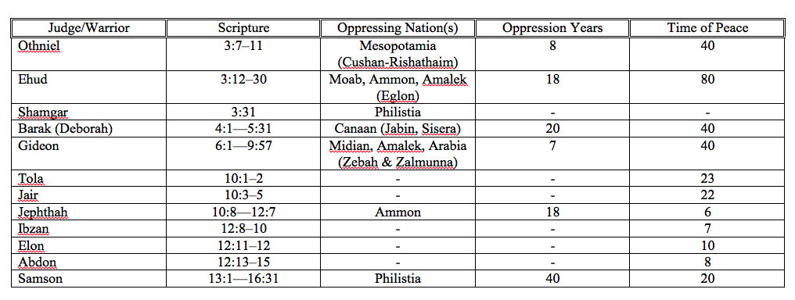

Slide 11
God’s Plans (Call & Obedience)
Judges 4:1—5:31

Slide 12
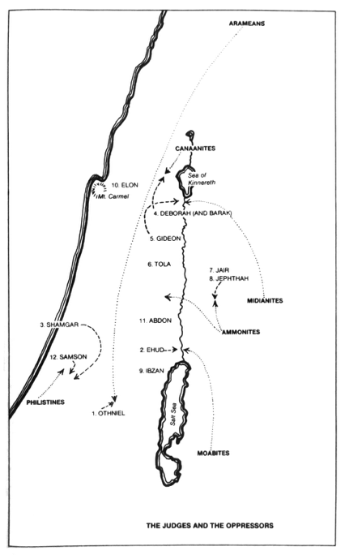

Slide 13
The Cycle (Judges 4:1–3)
Enemies — Jabin (King of Canaan) and Sisera (the commander of Jabin’s army)
Weapons — 900 iron chariots
Oppression — 20 years

Slide 14
God’s Plan: The Call (4:4–10)
Prophetess Deborah
Judge/Warrior Barak
The Command (Judges 4:6)
The Hesitancy (Judges 4:8)
The Consequence (Judges 4:9)

Slide 15
God’s Plan: The Obedience (4:11–23)
Jael the tentmaker (Judges 4:11–23)
The victory song (Judges 5:1–31)
The land had peace for 40 years

Slide 16
The Message
Two Plans: Call and Obedience
(cp. Matt 21:28–32)

Slide 17
The Message
God is in a rescue/reconciliation mission; Paul and apostles were working along with Him in the rescue mission (2 Cor 5:18–21).
Call // Obedience

Slide 18
Black

Slide 19
OT Sermons link at biblestudydownloads.org
Get this presentation and script for free!

